Slide 1
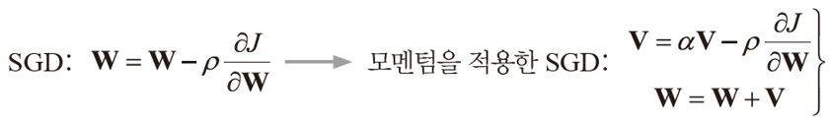


AI-based medical image processing algorithm application research for telemedicine
Chosun University
Hee-Soo Ryoo, Woo-Young Jang, Geon-Woo Park
1. Absract
2. Proposed Work
Uses deep learning algorithms for medical information to validate algorithms and key models of medical artificial intelligence systems that can read images, diagnose diseases, and predict prognosis
To demonstrate the effectiveness of AI deep learning in telemedicine medical image processing, we focus on the key optimization tools among the hyperparameters of each model
Individual learning is performed according to the characteristics of the medical image. At this time, when there is little medical information data to be used for learning, the performance of each deep learning algorithm model is measured and compared.
AI Model optimization function for medical image
Stochastic Gradient Descent (SGD) is the most basic optimization function, which learns to minimize differentiable functions.
Root Mean Square Propagation (RMSprop) is an optimization function that compensates for the disadvantages of SGD.
Adaptive Moment Estimation (Adam) stores the exponential mean of the slope calculated so far, similar to the Momentus method.
Standard SGD uses a fixed learning rate, and moves conservatively using a small learning rate (such as 0.001, 0.0001). Adaptive learning rate adjusts the learning rate according to the situation .
RMSprop improves AdaGrad by reducing its influence as it ages when accumulating gradients. Adam applies the momentum in the above formula to RMSprop
AI convergence College

Slide 2
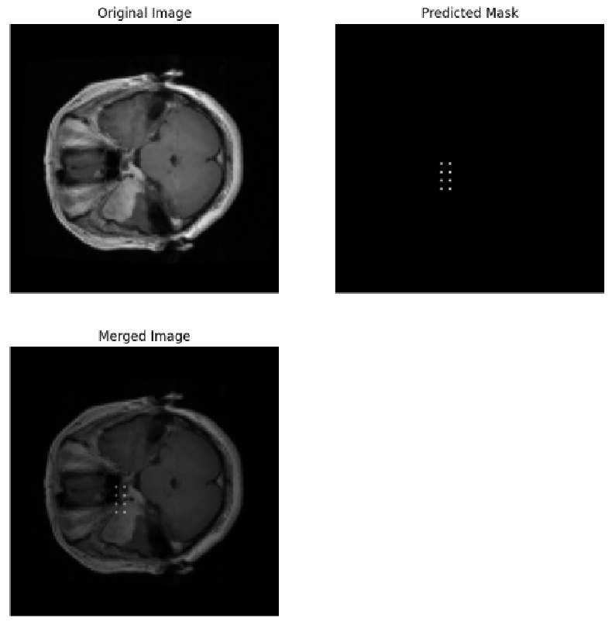
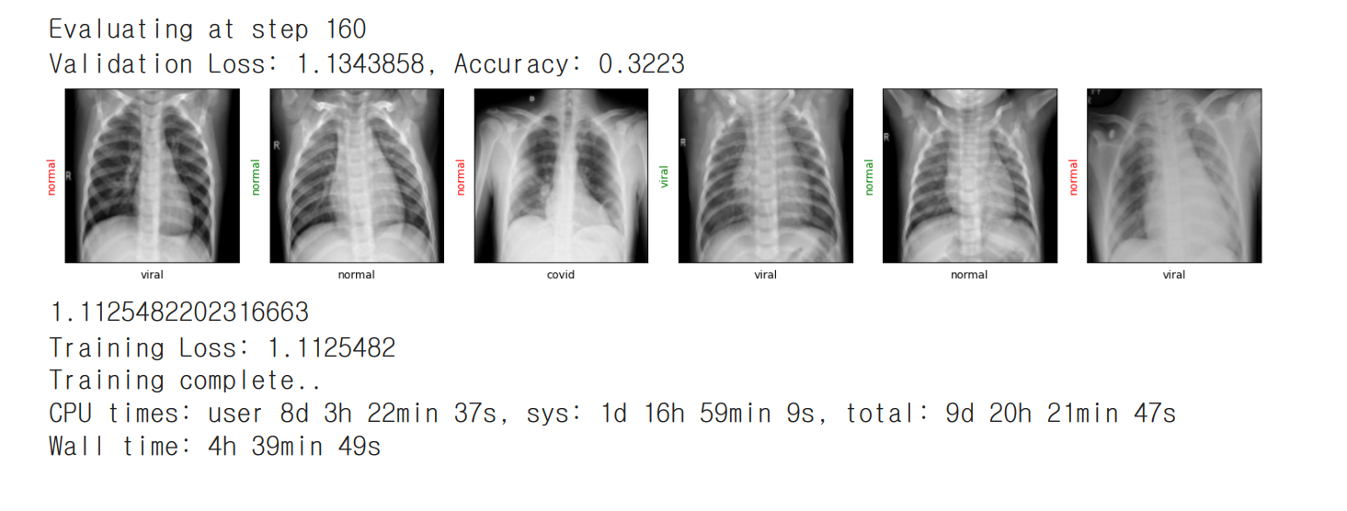
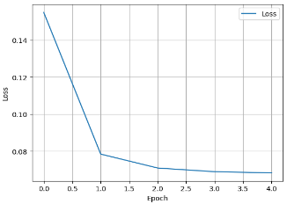
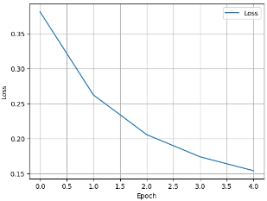
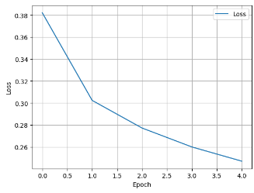
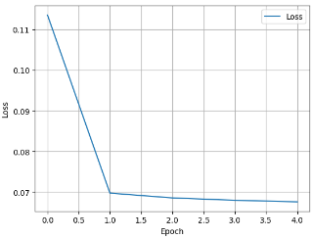
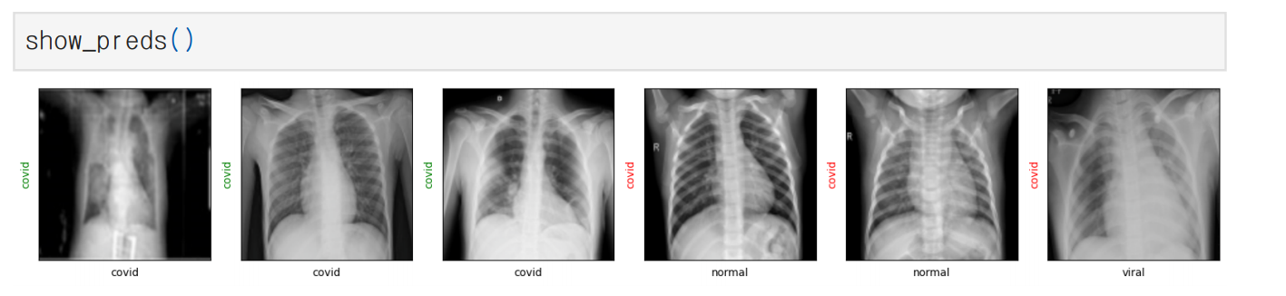
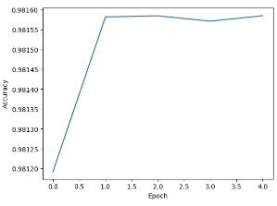
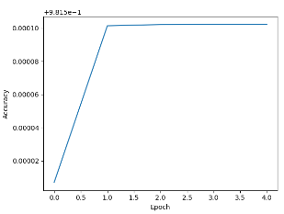
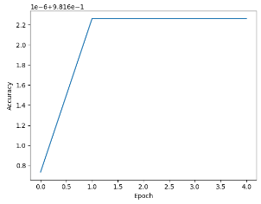
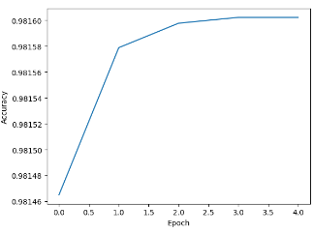
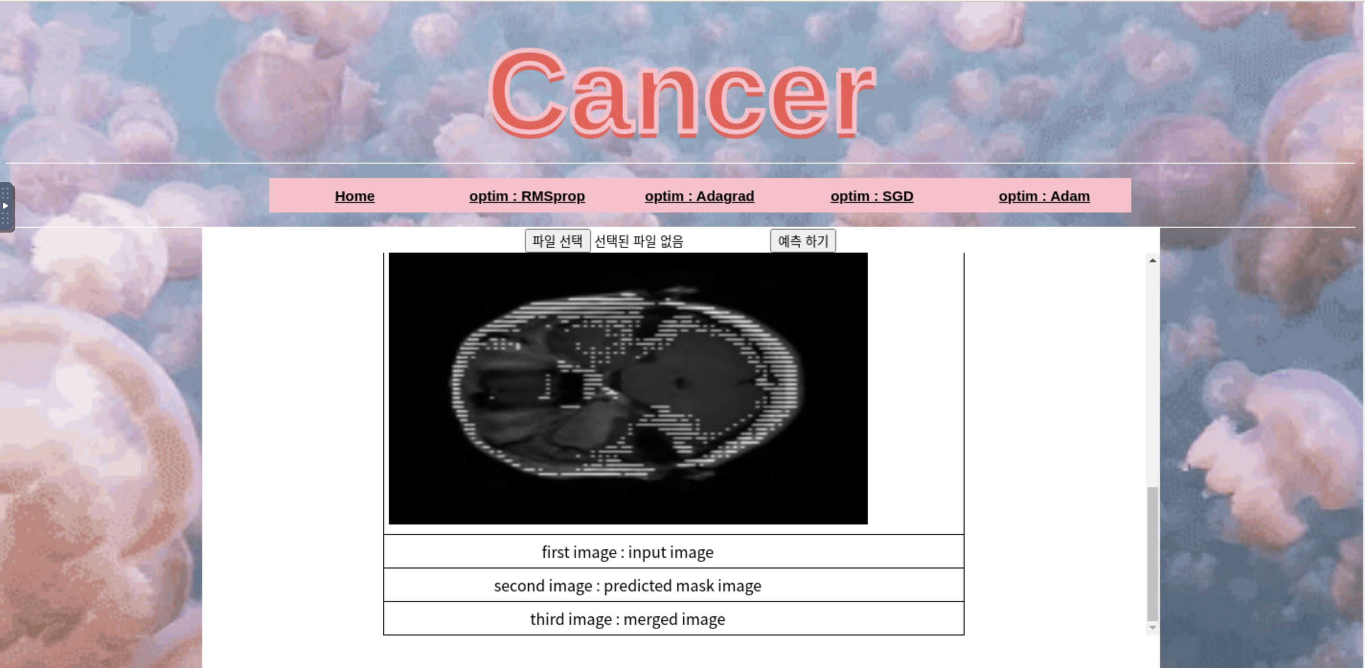
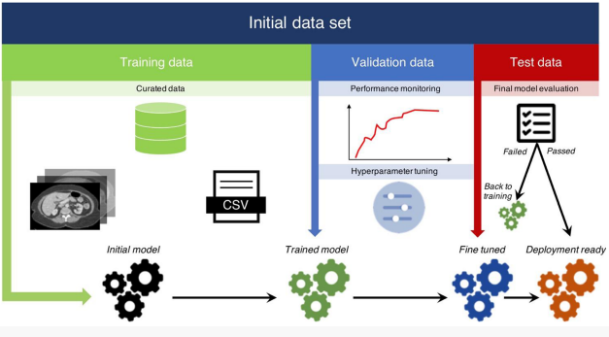
3. Applying model to Brain Tumor and Lung disease
4. Appropriate model development and application
After applying various major optimizers to U-Net model, ‘U-net + ResNet50’ to brain tumor or lung diseases classification models, we got a lot the following results depend on models for the affected tissue data processed by us.
Brain tumor and Lung disease models using Adam optimizer 그 뒤는?
- Loss for Brain Tumor
Adam | SGD | Adagrad, | RMSprop
Prediction for Brain Tumor | Prediction for Lung disease
- Accuracy for Brain Tumor
( a ) ‘U-Net+ResNet50’S-based model validation results by Adam optimizer
Adam | SGD | Adagrad, | RMSprop
Figure ‘U-Net+ResNet50’-based model development and performance diagram
Disease prediction menu with model | Final performance evaluation by the model
( b) Full execution System Picture (UI/UX)
5. Conclusion
Figure. The model validation results with ‘U-Net + ResNet50‘ structure and execution
AI-based medical image processing holds significant potential for enhancing telemedicine practices.
By leveraging deep learning algorithms, it is possible to automate object detection, segmentation, and classification tasks in medical imaging, leading to improved image quality and diagnostic accuracy.
The integration of AI technologies into telemedicine enables remote healthcare providers to access and analyze medical images efficiently, reducing the burden on medical professionals and improving patient care.
In terms of learning accuracy itself, Adam was high in most models, but Unet - Adagrad was detected with the highest accuracy when predicting

